Slide 1
Why do wars occur?
Nations compete over natural resources.
Individuals demand greater political and economic freedom.

Slide 2
We will study 3 aspects of WWII
The war in Europe against Germany and Italy
The war in Asia with Japan
The home front

Slide 3
What caused WWII in Europe?
Germany wanted back what she lost from WWI, and revenge
Appeasement – Great Britain and France gave Hitler land w/o fighting for it.
Hitler was racist; he invaded countries simply to kill the Jews living there.

Slide 4
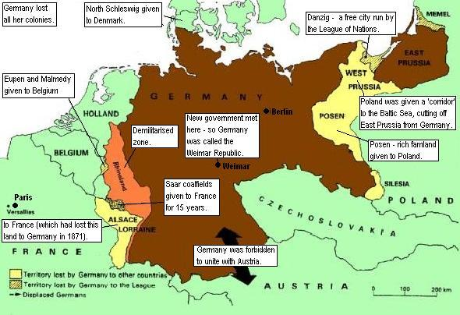
Treaty of Versailles – end of WWI
The main points of the Treaty [BRAT]
1. Germany had to accept the Blame for starting the war
2. Germany paid Reparations for the damage done during the war.

Slide 5
Versailles cont. .
3. Germany was forbidden to have submarines or an air force. She could have a navy of only six battleships, and an Army of just 100,000 men.

Slide 6
Versailles
4. Germany lost Territory (land) in Europe (see map). Germany’s colonies were given to Britain and France.

Slide 7
Review Questions
How did WWI help cause WWII?

Slide 8
Depression in 1920s Europe
Economy was bad in Europe
WWI killed a lot of workers and customers
After years of humiliation and starvation, Germans looked for a strong leader.

Slide 9
NAZIs elected to power!
Nazis promised to build up their army and get revenge for the WWI
This is Adolf Hitler 1933.

Slide 10
Totalitarianism
Mussolini (Italy) Hitler (Germany)

Slide 11
Germany late 1930s
Germany escaped the Depression by militarizing.
This is Berlin 1936

Slide 12
Appeasement – Hitler wanted land, Britain and France let him have it without war

Slide 13
WWII started when Hitler invaded Poland 1939.

Slide 14
Fortress Europa
In no time, Germany conquered most of Europe with tanks, planes, railroads.

Slide 15
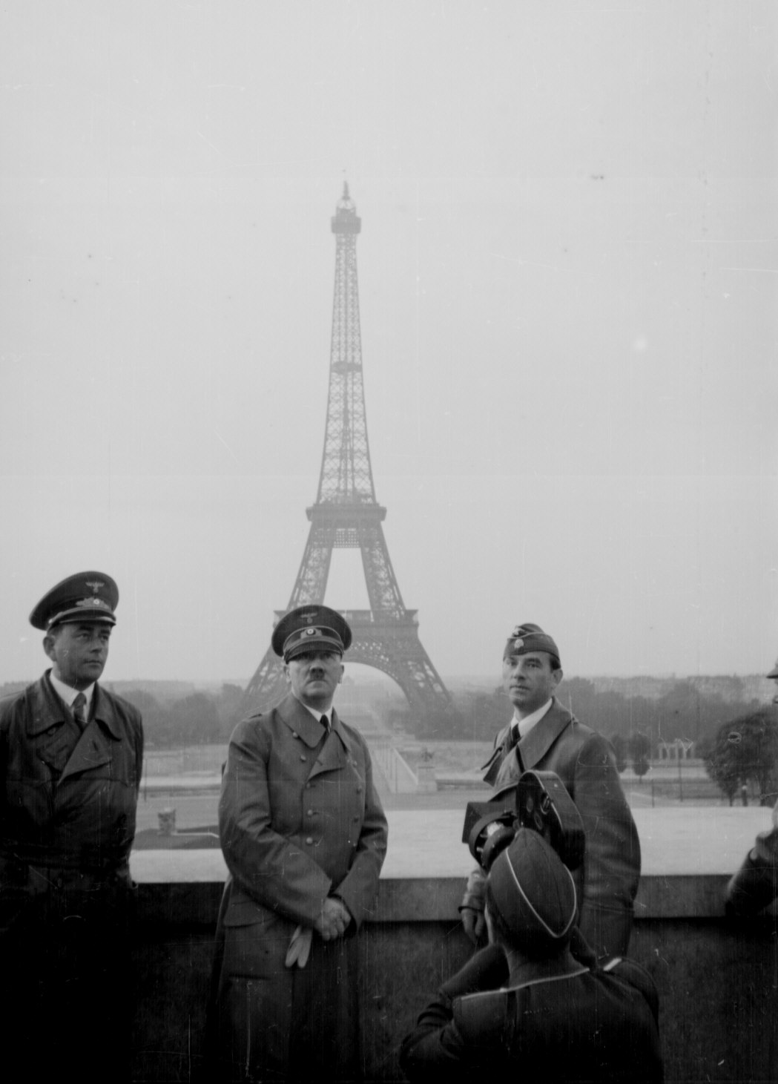
Hitler in Paris

Slide 16
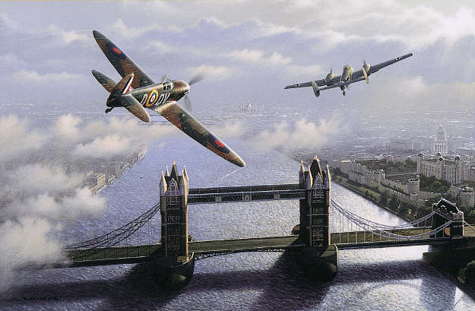
Battle of Britain
Battle of Britain

Slide 17
Tough cold winters killed many NAZI troops in USSR.
Russian people are tough! 21 million dead, yet no surrender!

Slide 18
Invasion of Normandy, France

Slide 19
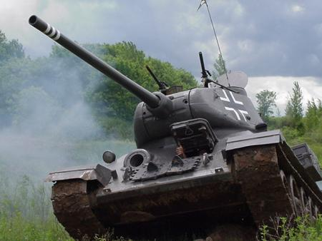
Tank!

Slide 20
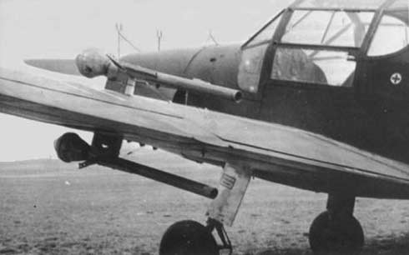
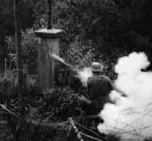
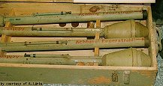
Anti-tank weaponry

Slide 21
English Channel protected England
Britain resisted German air force

Slide 22
Germany’s end
Germany invaded the Soviet Union and lost a million troops due to the cold and Russian bravery.
Germany spent too many resources trying to kill Jews and not supporting his troops
Germans fought Russians in the east and Americans and Brits in the West.

Slide 23
Germany surrenders April ‘45

Slide 24
Quiz (European front)
1. How was WWI a cause of WW2?
2. Define totalitarianism
3. Define appeasement
4. Name 2 countries that Germany invaded.

Slide 25
Meanwhile, in the USA. . .

Slide 26
US Isolationism
Americans wanted to stay out of Europe’s wars.
FDR wanted to help Britain anyway

Slide 27
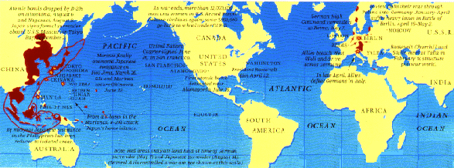
USA had 2 oceans to protect them (sort of).

Slide 28
Lend Lease Act
FDR sent war materials to Britain and the USSR.
This is a Sherman tank

Slide 29
Japan attacks Pearl Harbor. America enters WWII. December 7, 1941

Slide 30
Axis Powers
Germany and Italy declared war immediately after Pearl Harbor.
Germany, Italy and Japan made a deal to help each other in case on was attacked.

Slide 31
Allied Powers
The Allies were the USA, Great Britain, and the Soviet Union (USSR). These are called the “big three.”
In addition were the colonies and territories of these countries.
These include China, Canada, Australia, France, Poland and others.

Slide 32
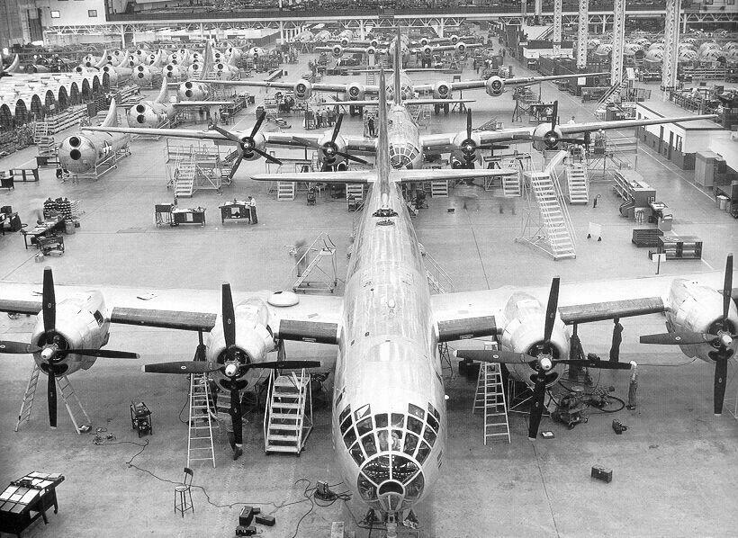
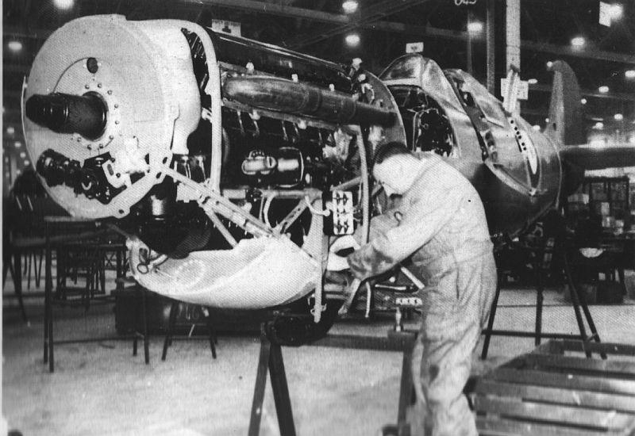
USA’s contribution was production, not blood.

Slide 33
Women in workforce

Slide 34
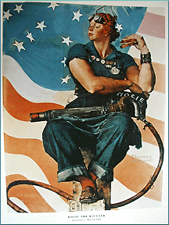
Rosie the Riveter

Slide 35
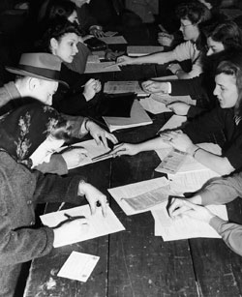
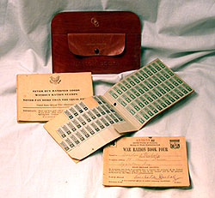
People rationed goods for war use.

Slide 36
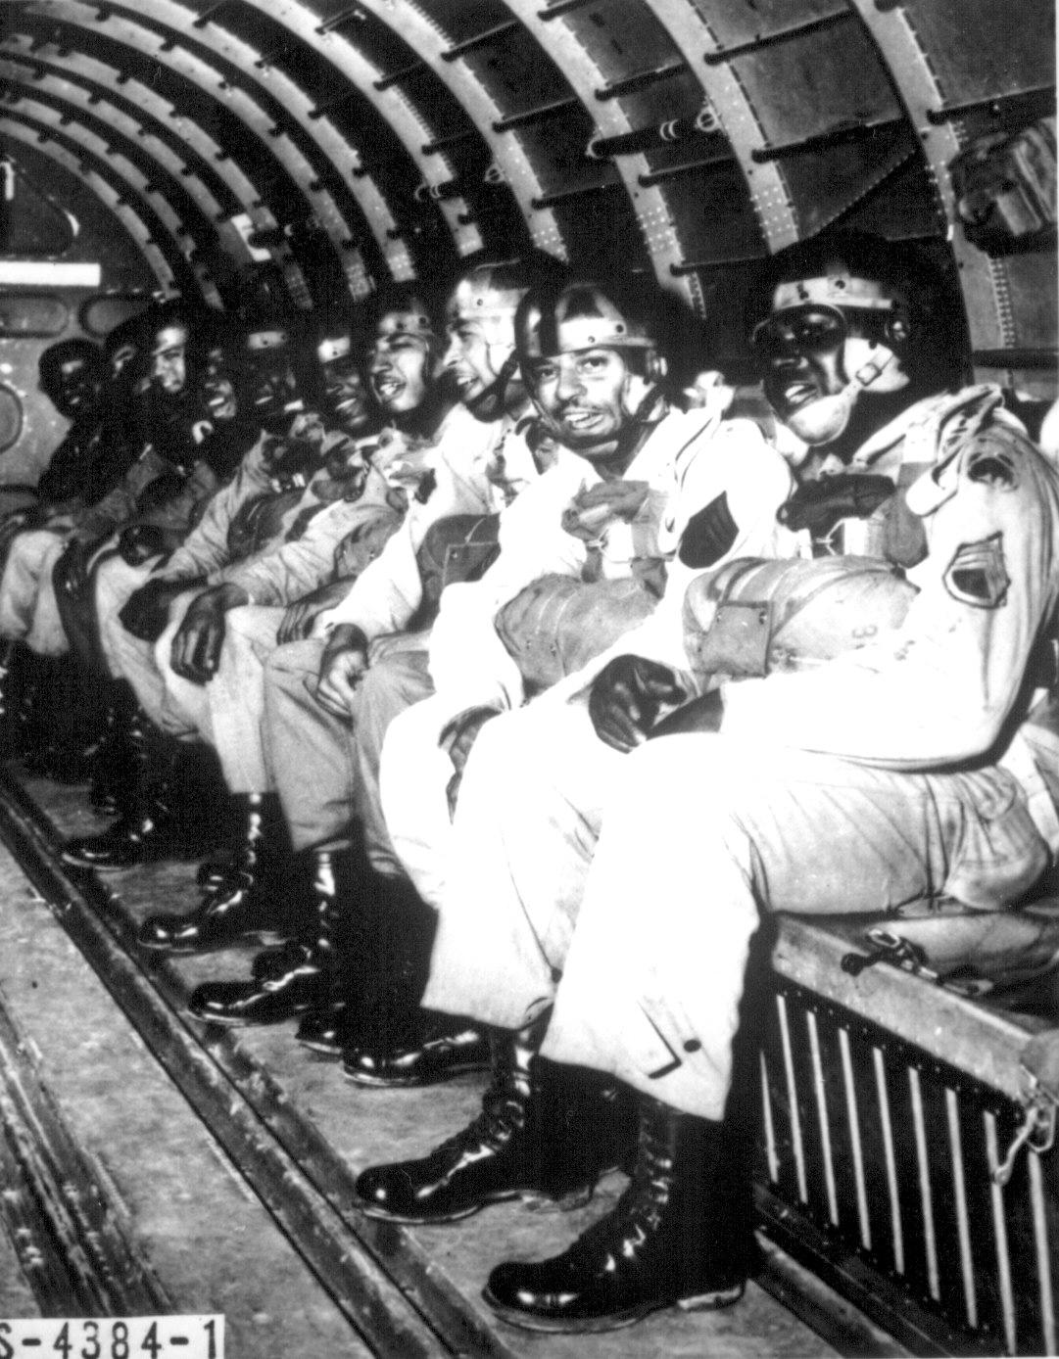
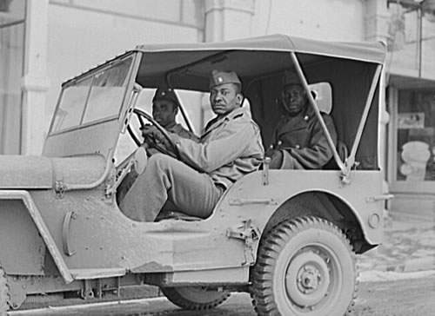
The Army was segregated, but African Americans served.

Slide 37
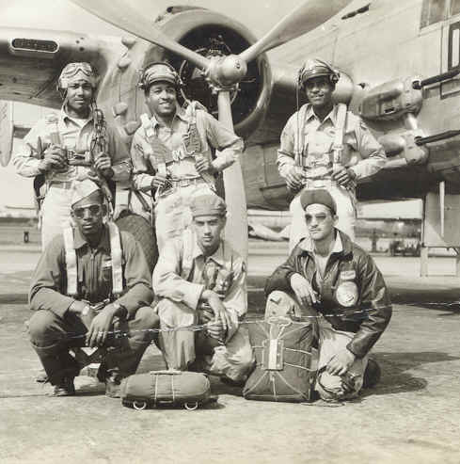
Tuskegee Airmen

Slide 38
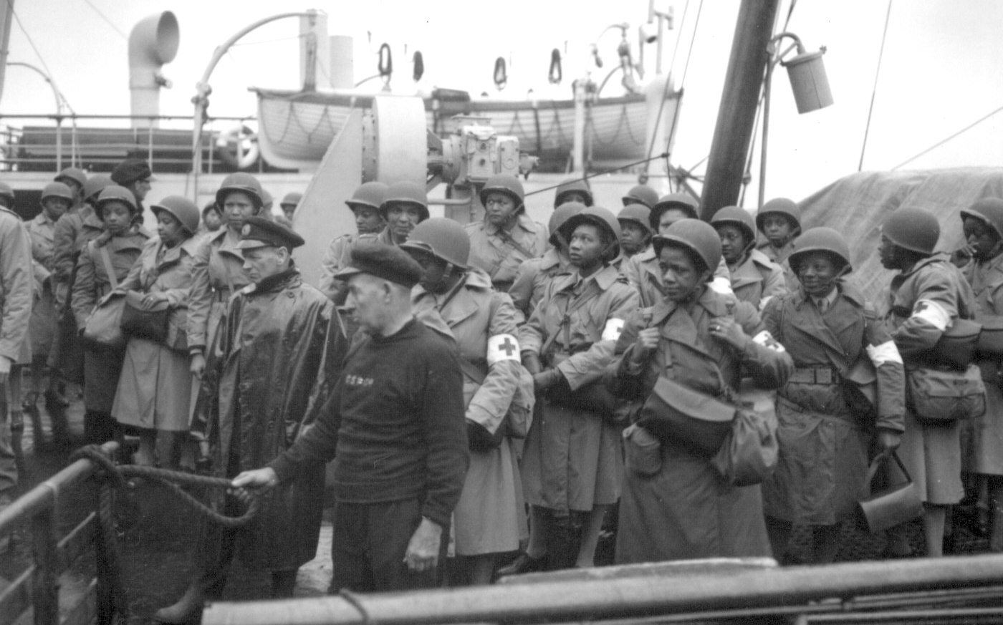
Women in the Forces

Slide 39
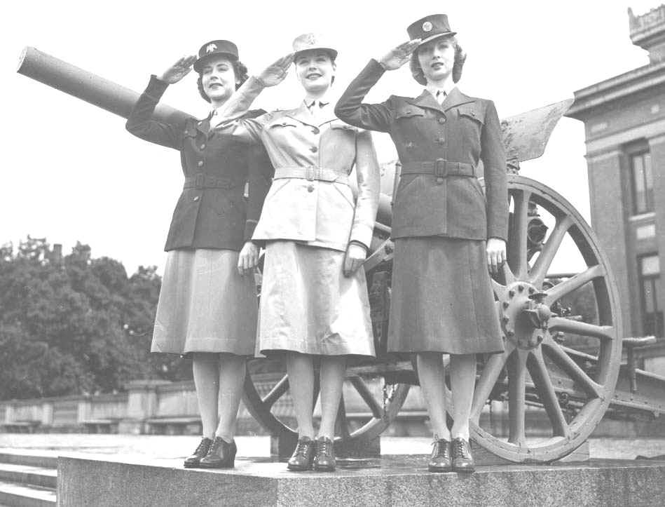
Women in Forces

Slide 40
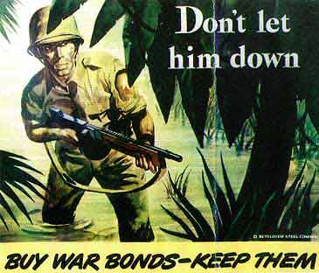
How did USA pay for this war?

Slide 41
Internment of Japanese Americans
USA was afraid if Japan were to attack the Pacific coast, Japanese Americans would help them.
The Government ordered them to move to camps.

Slide 42
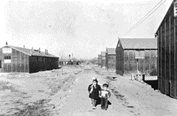
Internment camp

Slide 43
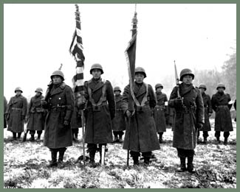
Strangely, Japanese Americans served in the Army

Slide 44
Any questions before the quiz?

Slide 45
Home Front Quiz
1. How did USA pay for WW2?
2. Who were the Allied powers besides the USA?
3. Why did the USA intern the Japanese Americans?
4. What was the Lend Lease Act?
5. When was the Pearl Harbor attack?

Slide 46
Meanwhile, in Asia. . .

Slide 47
Japan wanted China and the USSR.
Japan is an island, and not a big one.
They wanted more living space and resources for their “superior” people.

Slide 48
Japan wanted oil reserves
Japan wanted more oil to invade China.
America embargoed their oil in Indonesia
Japan considered this an act of war.

Slide 49
Japan joins Axis Powers
Germany was sick of the U.S. helping Britain with its lend lease program. Japan agreed to attack Pearl Harbor and distract the U.S. from Europe war.

Slide 50
Battle for Midway Island
If won, Japanese could have bombed Hawaii more from here.
Major turning point

Slide 51
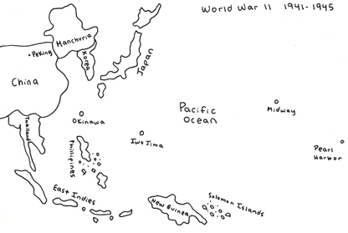
Island Hopping – US fought to gradually reach Japan

Slide 52
Battle for Iwo Jima
Island hopping became fact of the war with Japan.
Died: 6800 US 20000 Japanese.
This flag raising was a serious morale boost to soldiers on the island.

Slide 53
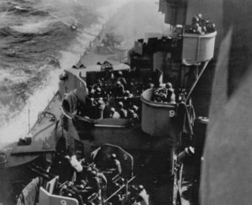
Kamikaze attacks

Slide 54
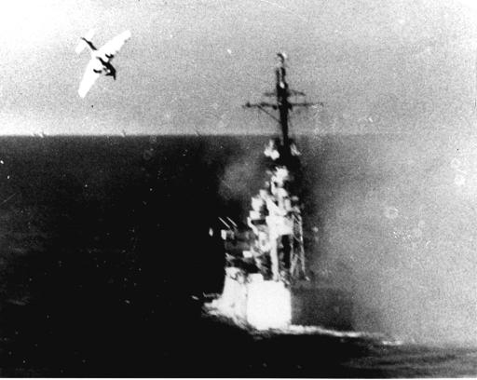

Slide 55
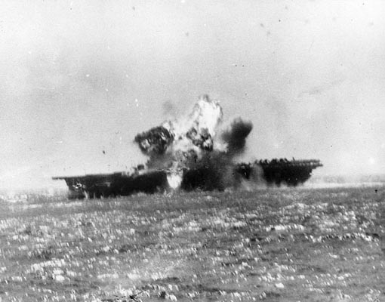

Slide 56
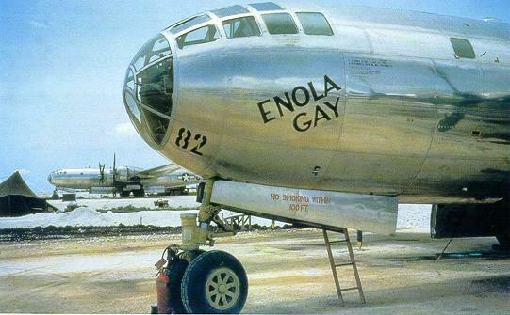
This plane dropped an atom bomb on Hiroshima

Slide 57
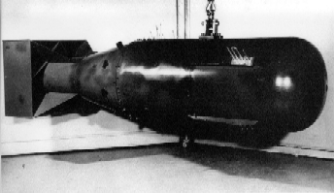
Atomic bomb

Slide 58
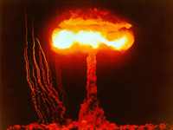
Hiroshima and Nagasaki 1945

Slide 59
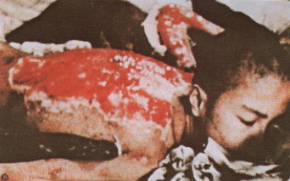
Victims in Hiroshima

Slide 60
Why drop the Atomic Bomb?
The Japanese had shown they would fight to the last man, woman and child.
The atomic bomb saved as many as 1 million U.S. lives, and possibly many Japanese.
Harry Truman said he dropped the bomb to end the war.

Slide 61
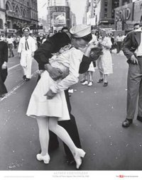
Japan surrenders 1945

Slide 62
World War II deaths
USSR 22 million
China 11 million
Germany 7 million
Poland 7 million
U.S. 0.5 million
Great Britain 0.3 million
Japan 1.5 million

Slide 63
Asia WW2 Quiz
1. What cities were nuclear bombed?
2. Define island hopping?
3. What was the importance of Midway Island battle?
4. Why did Japan want war with the USA?
5. What ocean protected USA from Japan?

Slide 64
This powerpoint was kindly donated to www.worldofteaching.com
http://www.worldofteaching.com is home to over a thousand powerpoints submitted by teachers. This is a completely free site and requires no registration. Please visit and I hope it will help in your teaching.

